Slide 1
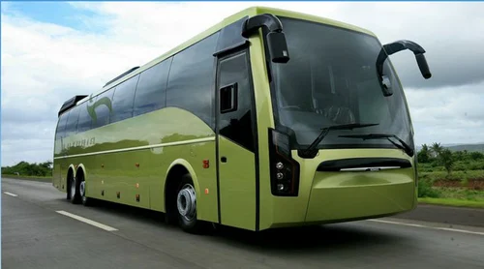
ONLINE BUS BOOKING SYSTEM
(GROUP 5 RLL)

Slide 2
TEAM MEMBERS:
EMPLOYEE ID | EMPLOYEE NAME
2568633 | Samrudh Kadabi
2567736 | Saptarshi Paul
2567212 | Shaik Raheem
2567740 | Shivukumar Babaladi
2567946 | Sulam Omprakash
2567111 | Toleti Lakshmi Amulya
2567582 | Vijayakumar Kumaravelu

Slide 3
INDEX:
Introduction
Project Scope
Tools and Technologies
Existing System
Proposed System
Flowchart
Admin Module
Admin Flowchart
User Module
User Flowchart
DB Schema
Output
Testing
Advantages
Future Scope
Conclusion

Slide 4
INTRODUCTION:
The Online Bus Booking System is an all-encompassing solution designed to streamline and simplify the bus ticketing process for both the company and its passengers.
With a user-friendly interface, it caters to the needs of passengers seeking efficient and convenient bus booking services, while also providing administrators with the necessary tools to manage buses, locations, schedules, and bookings seamlessly.
By integrating robust features and a dynamic platform, it aims to facilitate a smooth and hassle-free booking process, ultimately redefining the standards of online bus reservations.
With a focus on efficiency, security, and user satisfaction, our development efforts aim to propel the Online Bus Booking.

Slide 5
PROJECT SCOPE:
User Interface
Administrator Dashboard
Database Management
Security Measures
Responsive Design

Slide 6
TOOLS AND TECHNOLOGIES:
Front-End Technologies
The front-end of the online bus booking system is built using a combination of technologies to ensure a responsive and user-friendly experience for passengers.
The following technologies are employed:
•Angular, a widely adopted JavaScript framework for creating dynamic user interfaces.
•HTML5, CSS3, and JavaScript for structuring, styling, and adding interactivity to the web application.
Server-Side Technologies
The server-side of the online bus booking system is responsible for handling passenger and admin requests, processing data, and interacting with the database. The following technologies are utilized:
Spring Boot, a Java-based framework for building robust and scalable server-side applications.
Tomcat, a widely-used servlet container for deploying Java web applications.
Back-End Technologies
The back-end of the online bus booking system is responsible for managing the database and ensuring data integrity. The following technologies are incorporated:
MySQL, an open-source relational database management system.
Hibernate, a Java-based Object-Relational Mapping (ORM) framework that simplifies database interactions.

Slide 7
EXISTING SYSTEM:
Manual and Paper-Based Processes: The offline bus booking system relies on manual and paper-based processes, leading to slower operations in comparison to digital systems. This results in delays in ticket booking, route information, and fare updates, which can frustrate passengers.
Data Inefficiencies and Errors: Offline systems introduce data inefficiencies and errors due to manual data entry and paperwork handling. This raises the risk of inaccuracies in bus schedules, routes, and fares, impacting the overall passenger experience.
High Costs: The system involves high costs associated with agents or customer service representatives for ticket booking, route information, and fare inquiries. Passengers may face additional expenses and inconveniences.
Limited Accessibility: Passengers have limited access to real-time information and services. This hinders their ability to make informed decisions regarding bus schedules and routes.
Security Concerns: Offline systems may have security concerns related to data handling and storage, potentially putting passengers' information at risk.

Slide 8
PROPOSED SYSTEM:
Convenient Booking: Passengers can easily search for available buses, routes, and fares from the comfort of their own devices, enabling quick and hassle-free ticket booking.
Real-time Updates: Passengers can access up-to-date bus schedules, routes, and fares, ensuring they are always well-informed about their travel options.
Efficient Administration: Admins have a user-friendly dashboard for managing bus schedules, routes, and fares. They can add, edit, and delete buses and related information effortlessly.
Cost Savings: There will be no middle-man or agents involved in between. So, this transition simplifies the passenger experience and optimizes internal processes, leading to improved operational efficiency and associated cost reductions.
Data Accuracy: Digital data management minimizes the risk of inaccuracies in policy details and claims processing, enhancing the overall passenger experience.

Slide 9
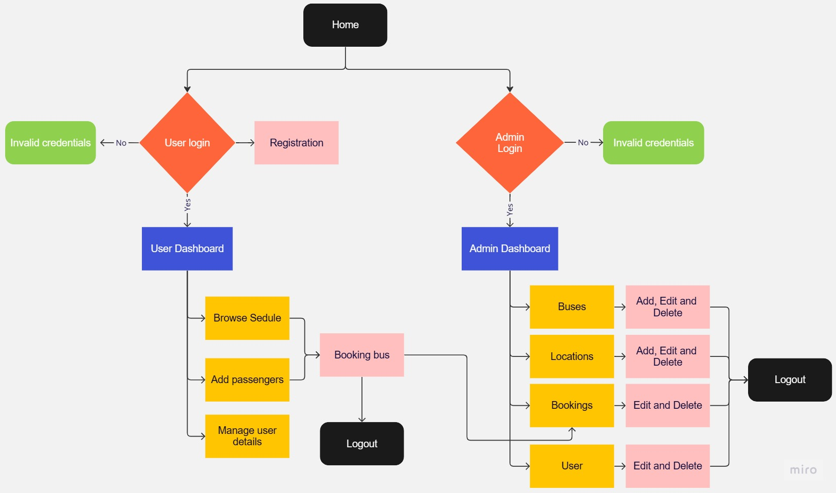
FLOWCHART:

Slide 10
ADMIN MODULE:
Bus Scheduler.
Bus Management Module.
User Management Module.
Location Management Module.
Payment’s Management Module.

Slide 11
ADMIN OPERATIONS:
Admin can Login to the Admin Panel.
Admin can View / Delete User’s.
Admin can View / Add / Update / Delete – LOCATIONS.
Admin can Schedule / Add / View / Update / Delete – BUSES.
Admin can Manage / Update Payment status of Booking’s.

Slide 12
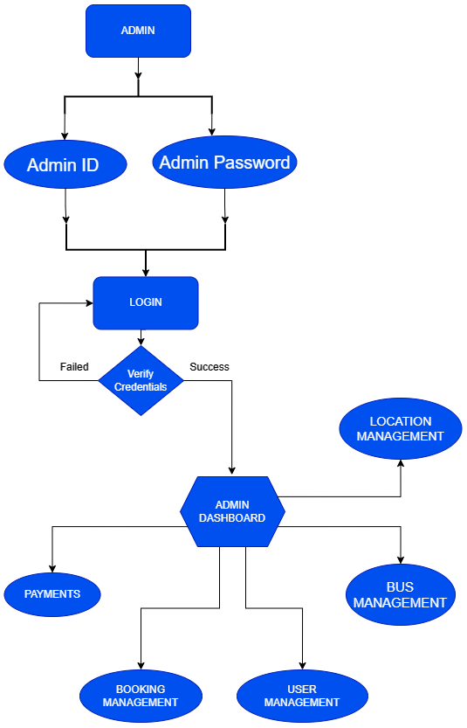
ADMIN FLOWCHART:

Slide 13
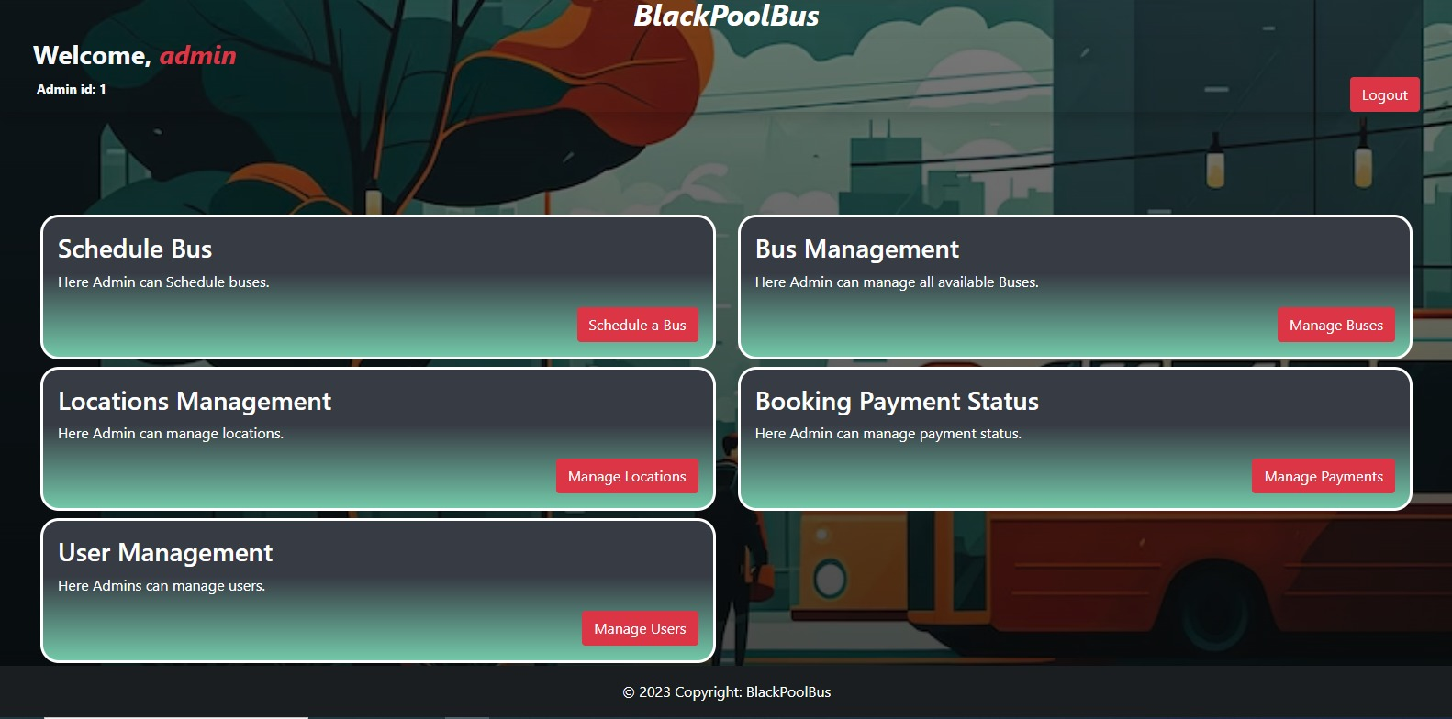
ADMIN DASHBOARD:

Slide 14
USER MODULE:
My Bookings
My Profile
Update Profile
Book Buses

Slide 15
USER OPERATIONS:
Create account (no approval required by admin)
Change the Password.
Change Name, Email, Mobile Number.
View user profile.
Search available busses based on location.
User can Book bus by adding Passenger details.
View all booking details
Update the passengers

Slide 16
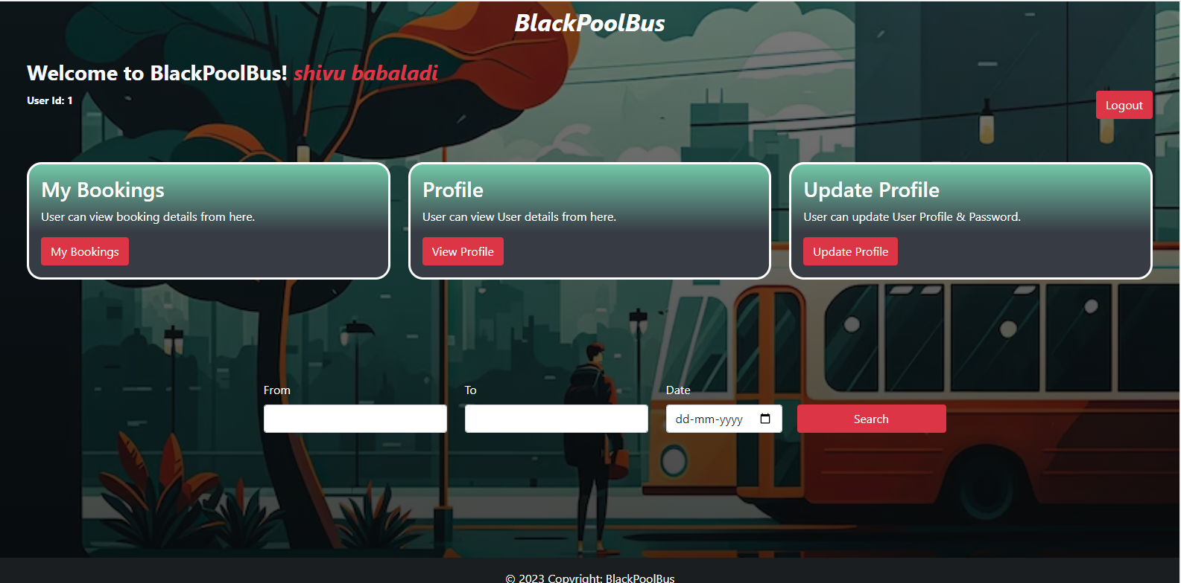
USER DASHBOARD:

Slide 17
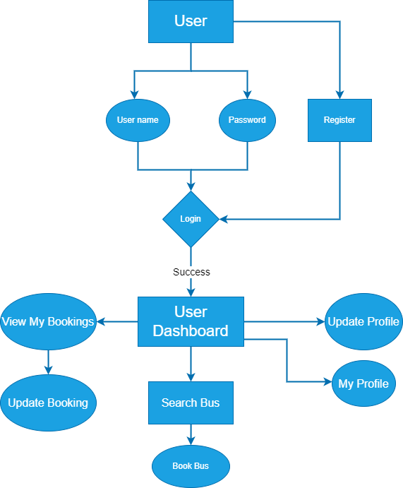
USER FLOWCHART:

Slide 18
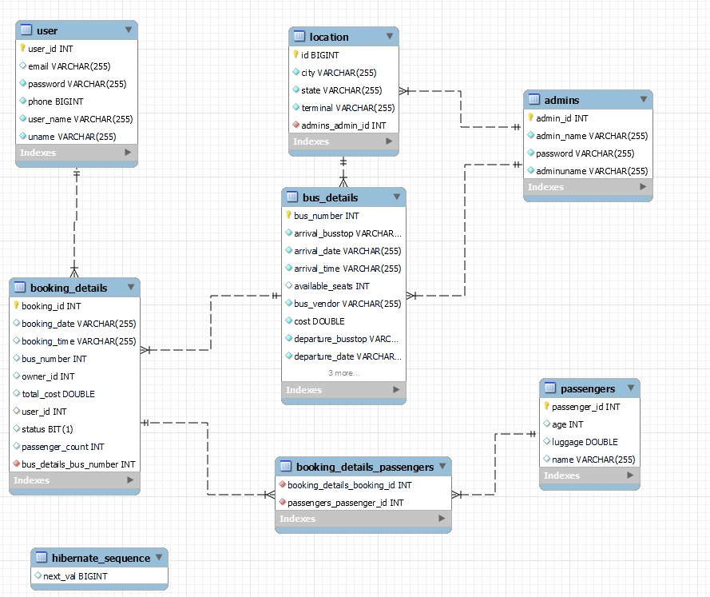
DB SCHEMA:

Slide 19
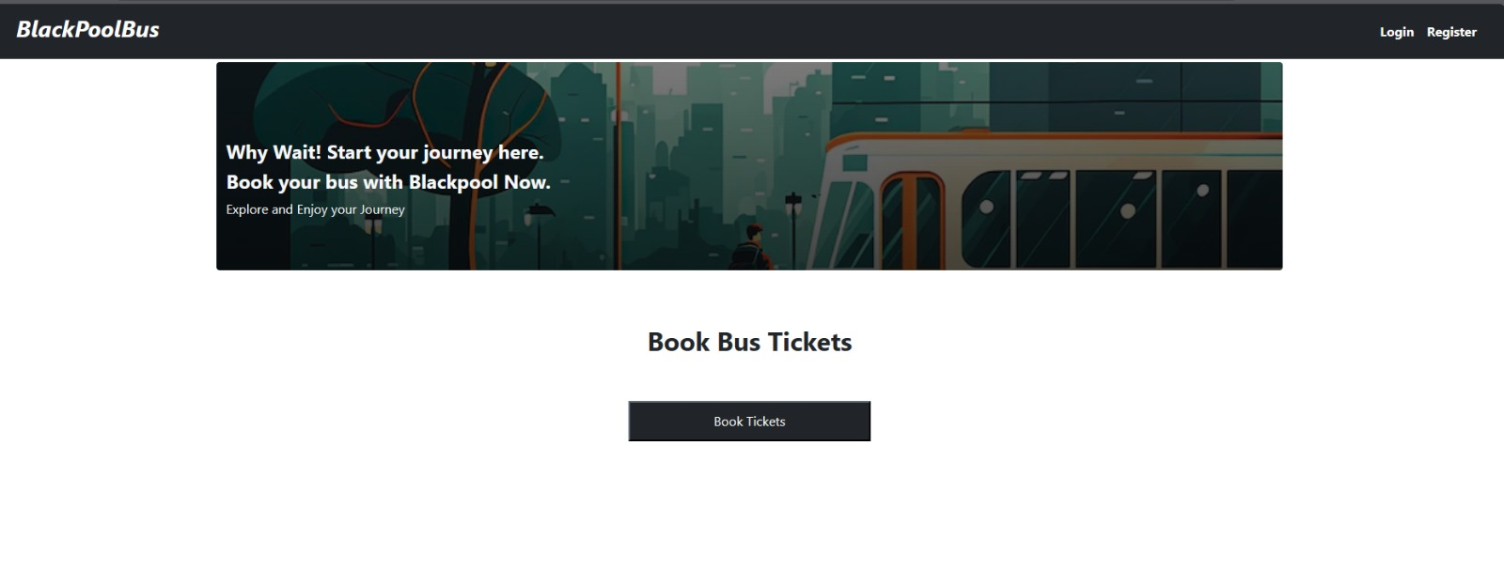
OUTPUT SCREENSHOT’S

Slide 20
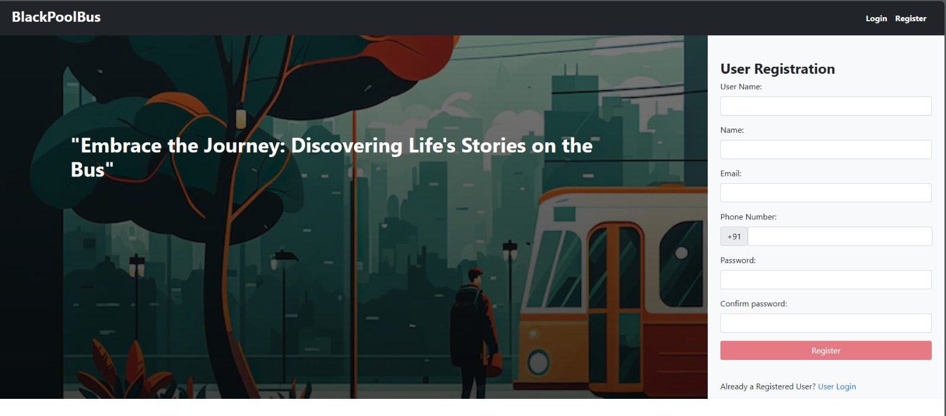
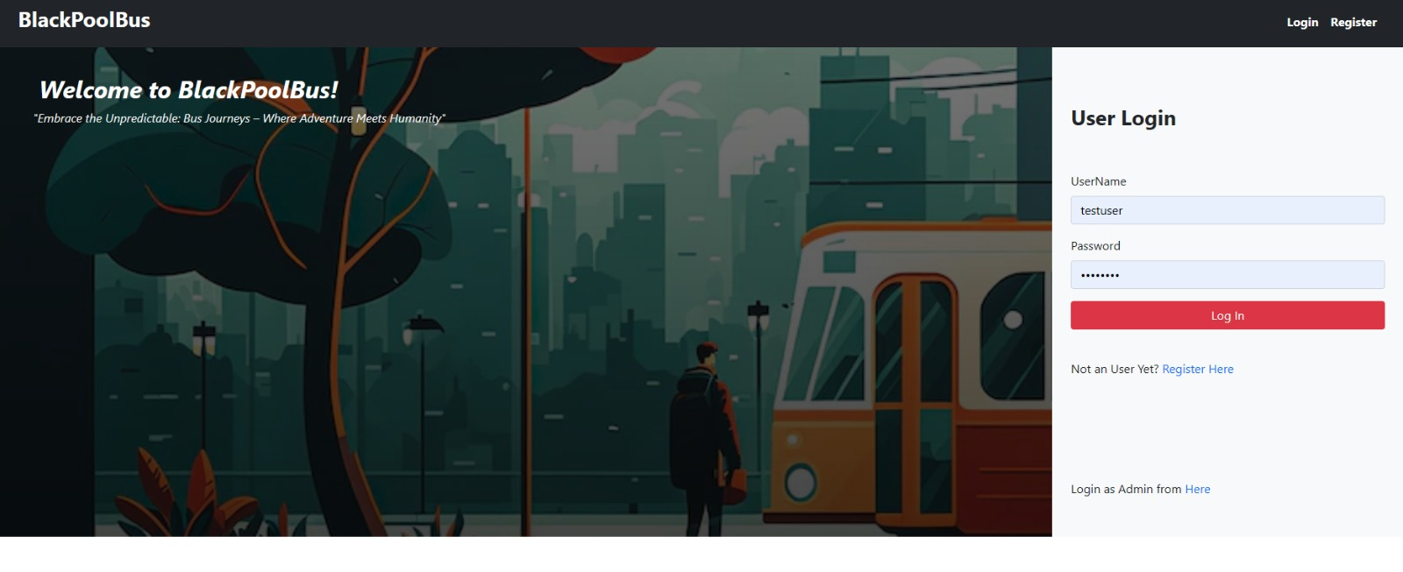

Slide 21
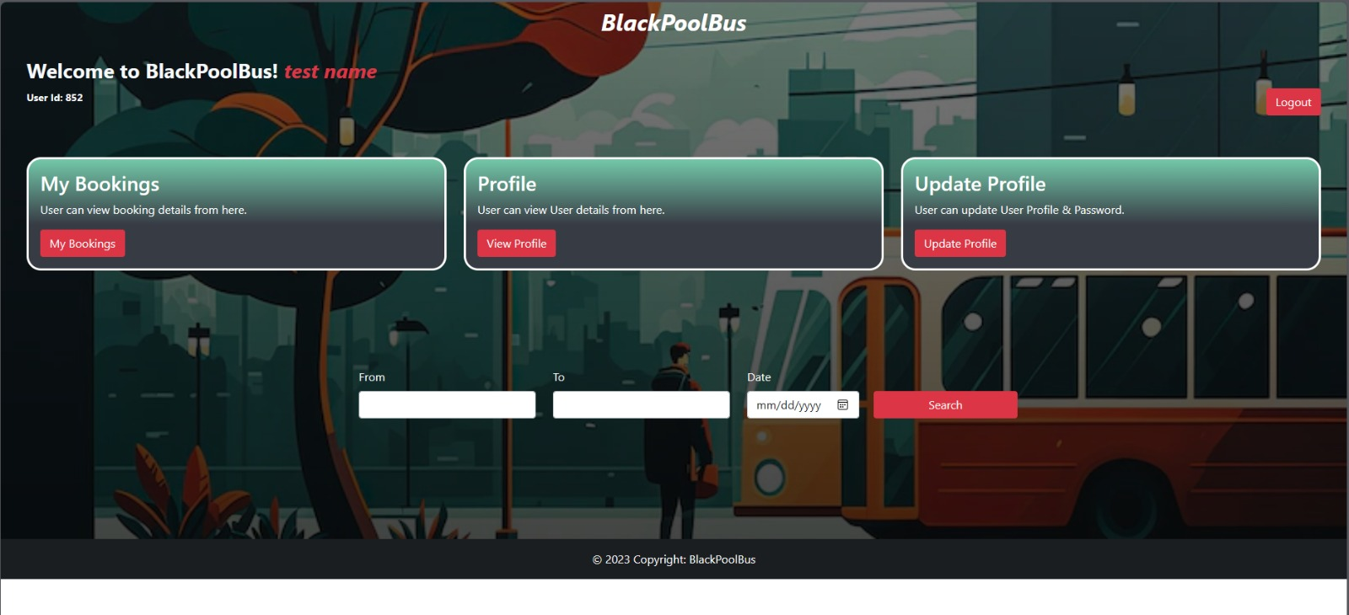
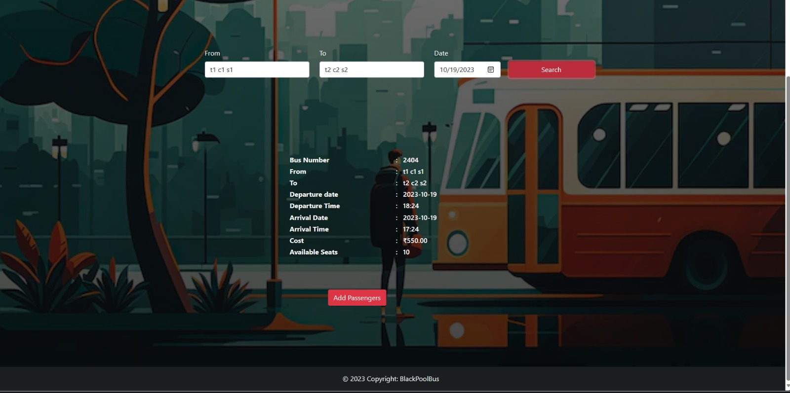

Slide 22
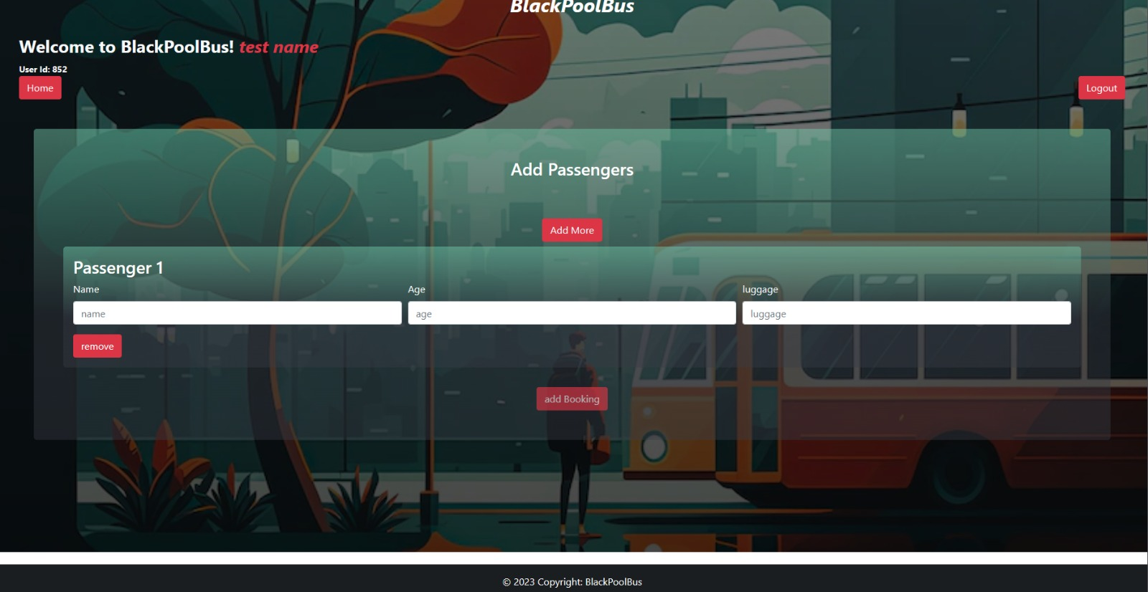
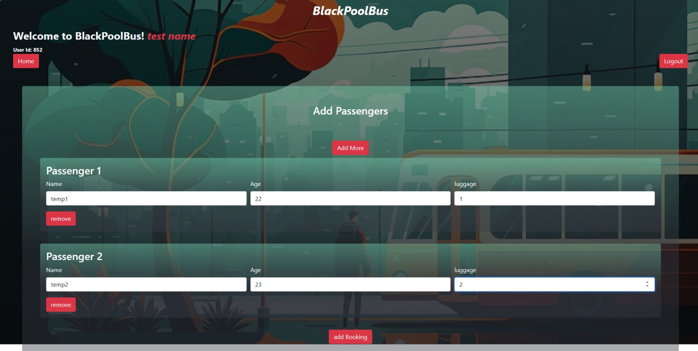

Slide 23
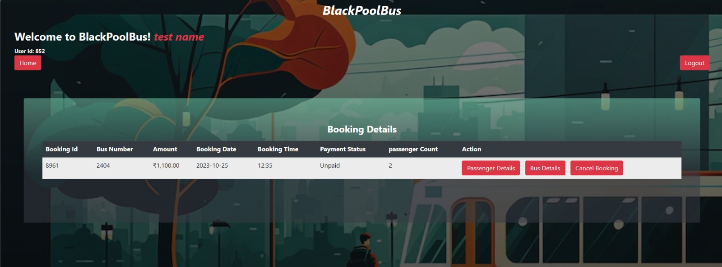

Slide 24
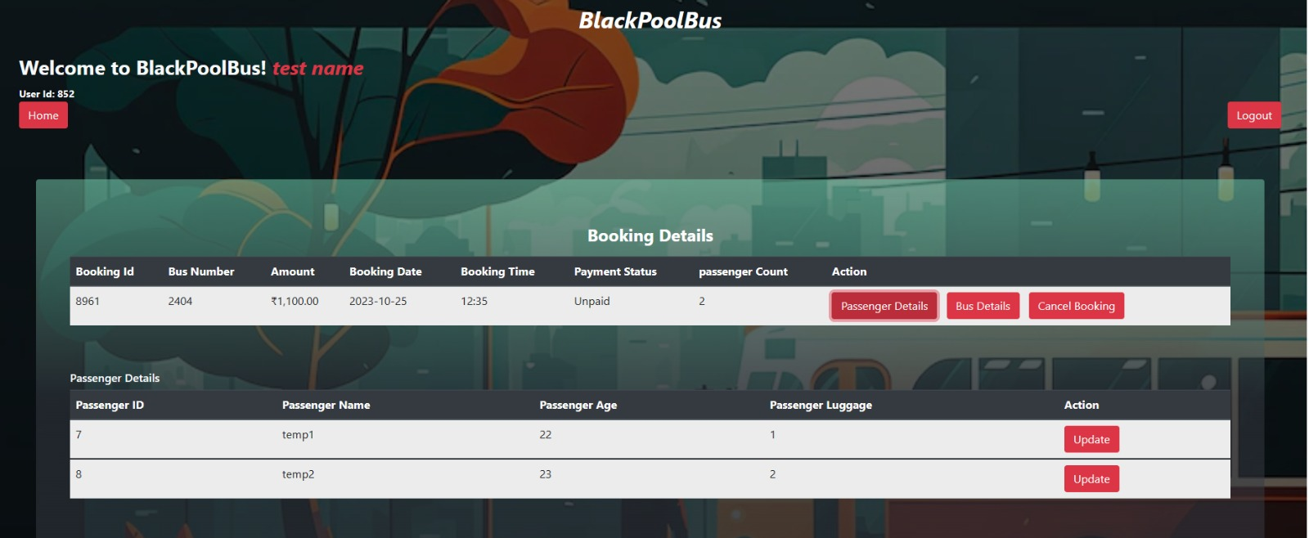
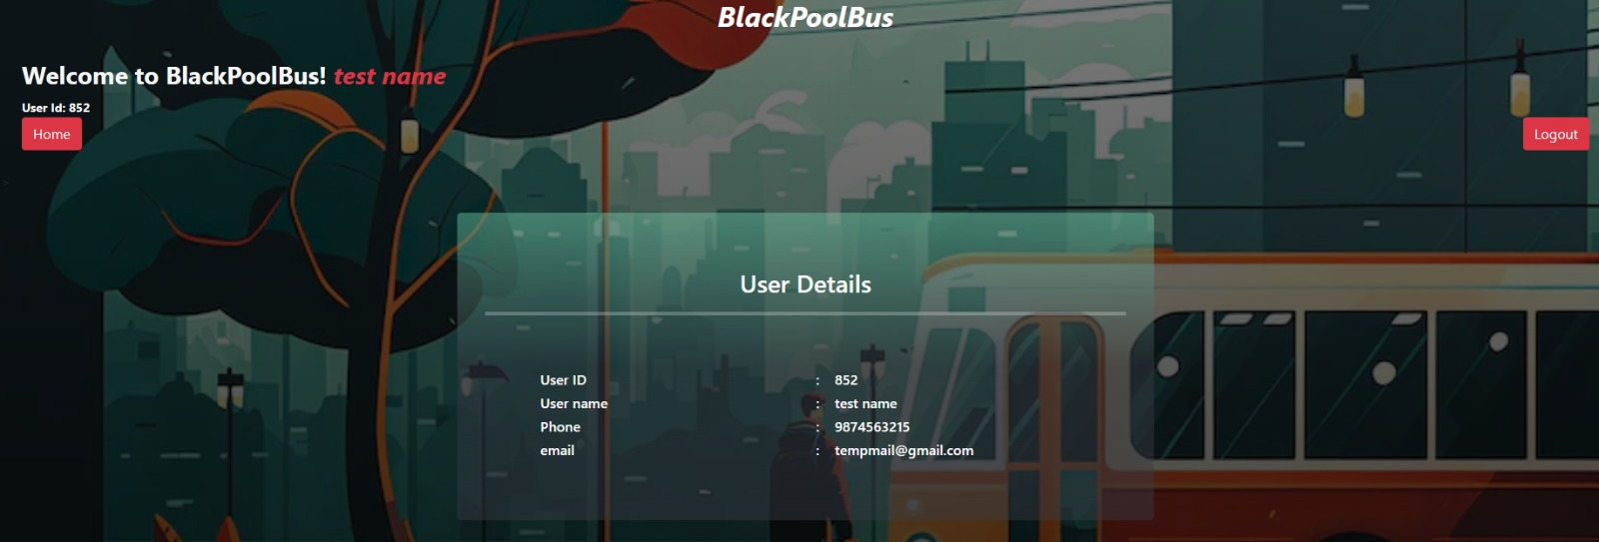

Slide 25
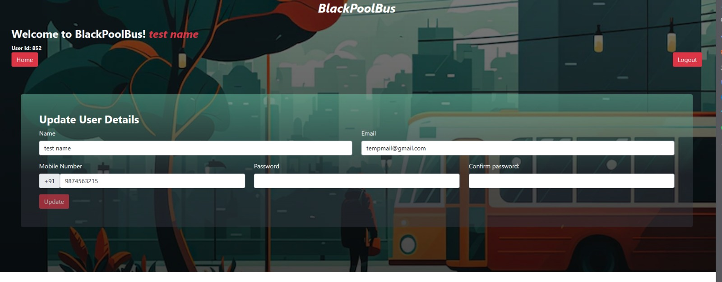

Slide 26
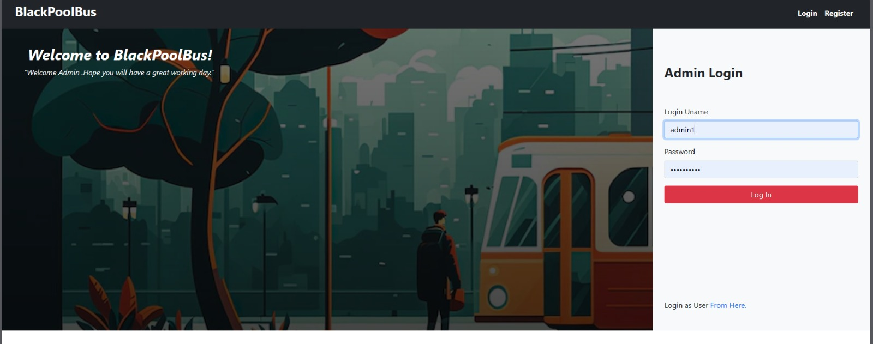
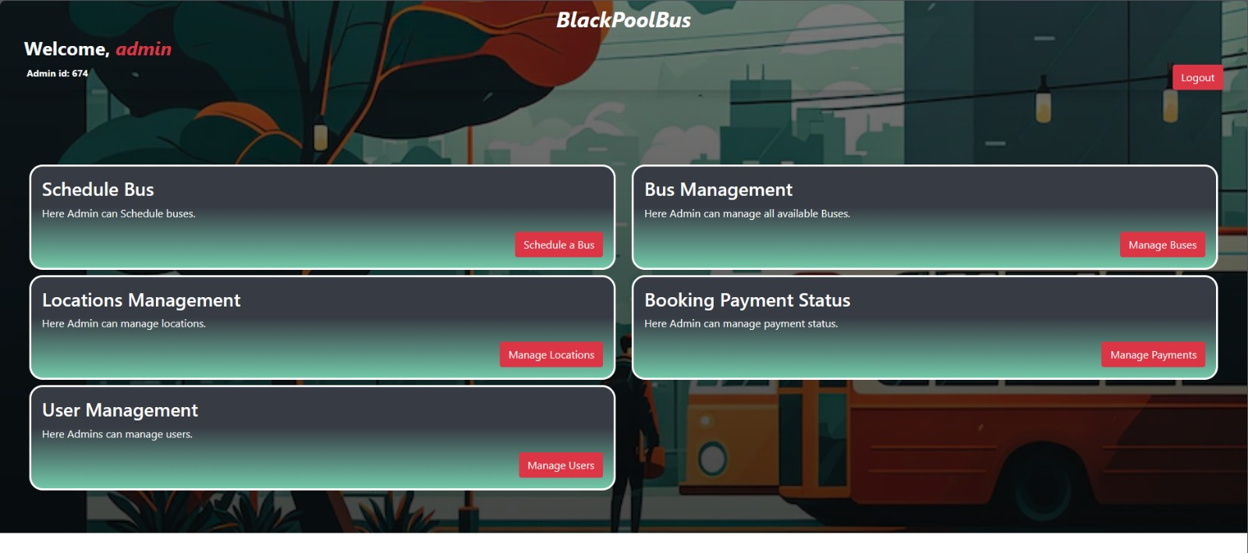

Slide 27
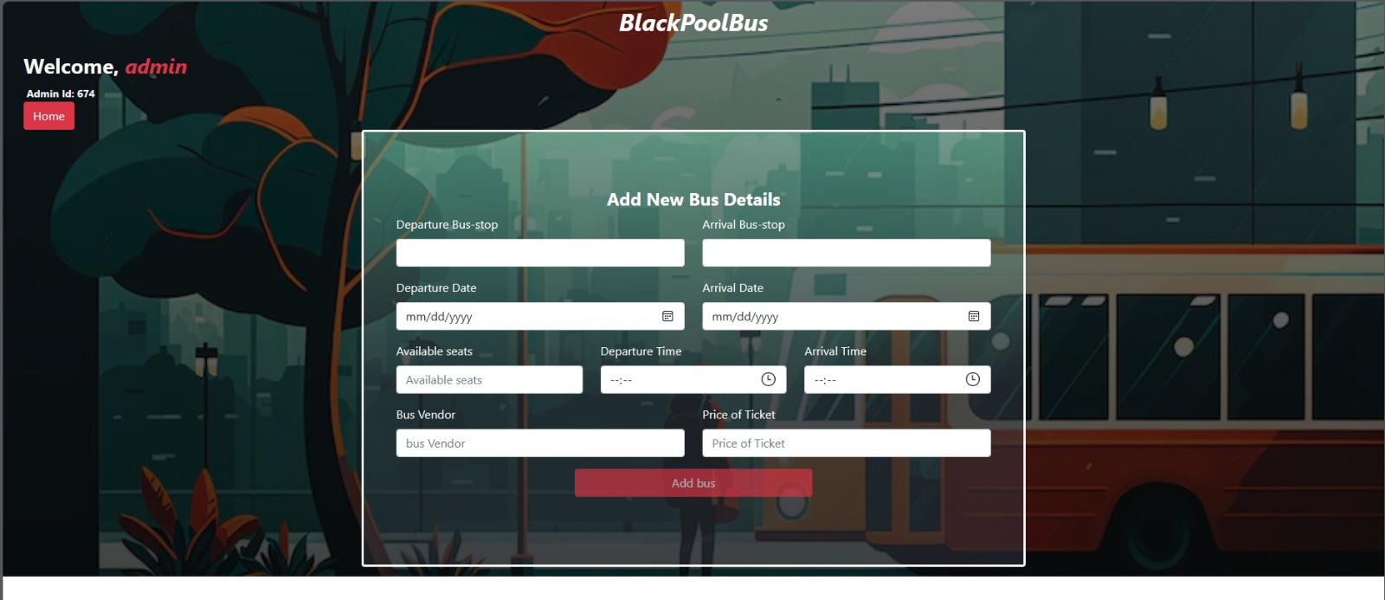
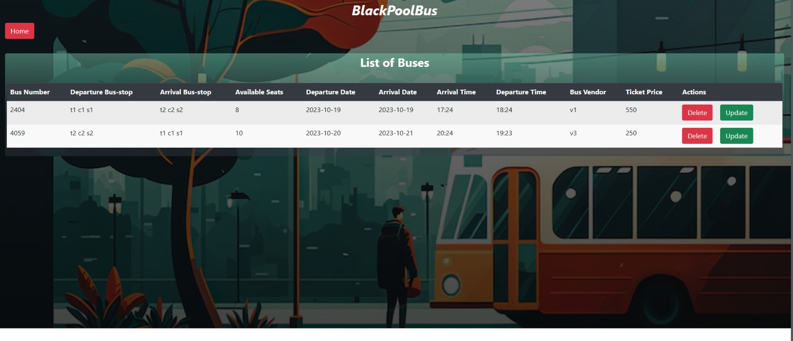

Slide 28
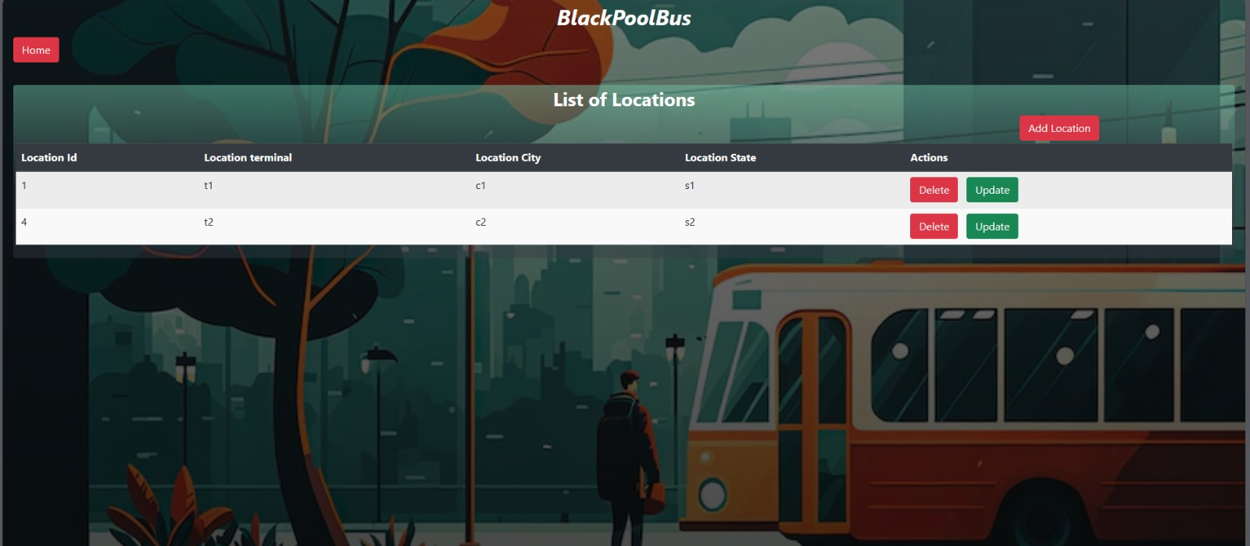
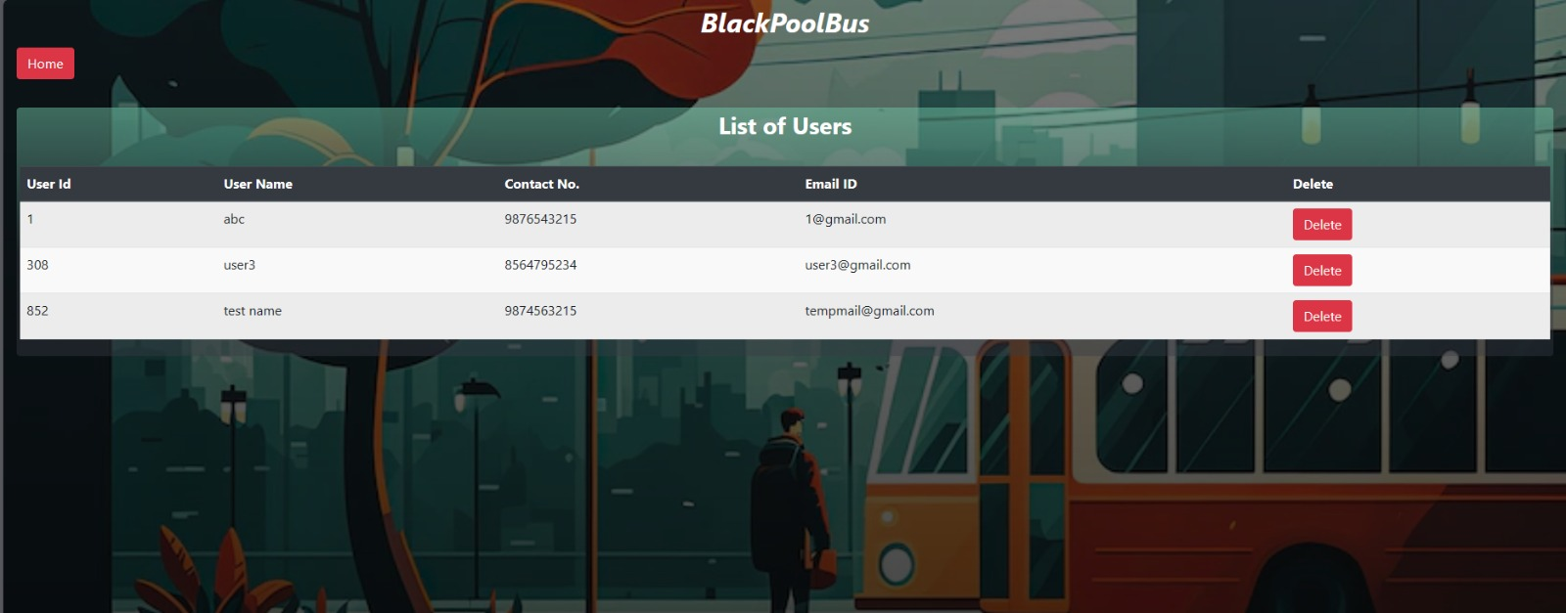

Slide 29
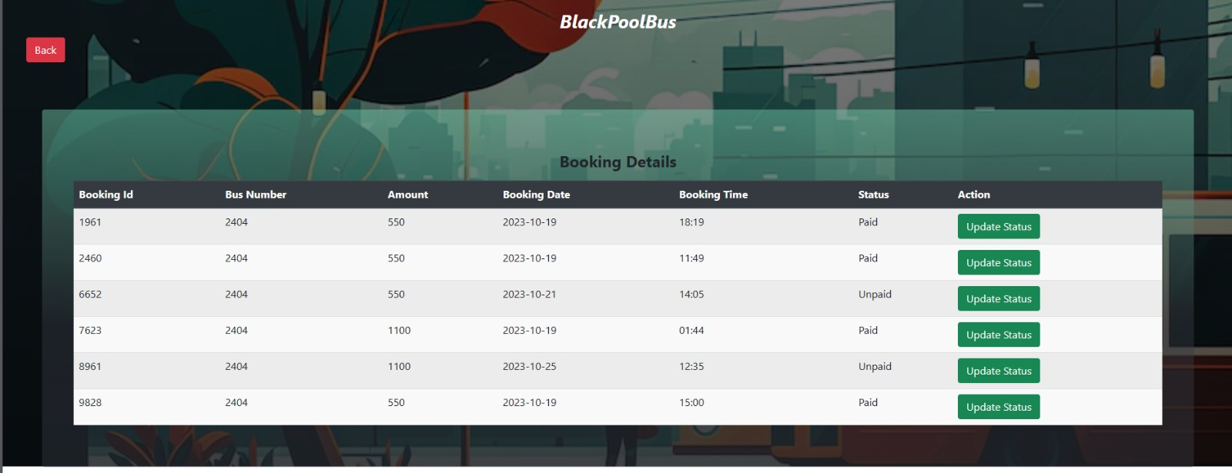

Slide 30
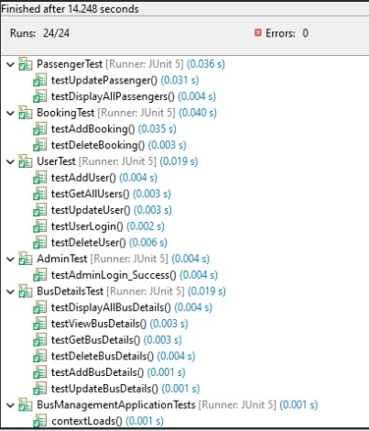
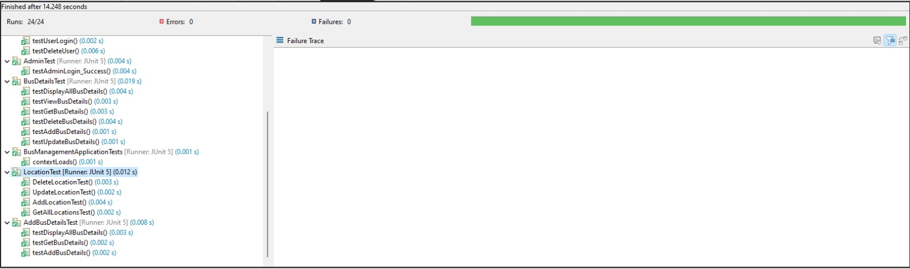
JUNIT TESTING:

Slide 31
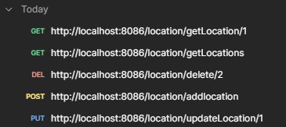
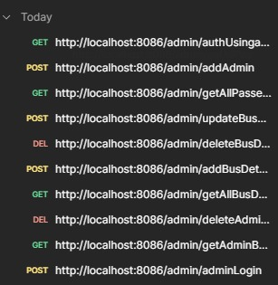
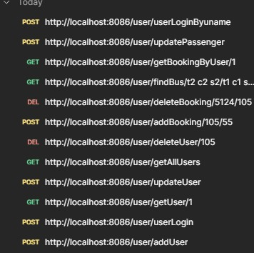
POSTMAN TESTING:

Slide 32
ADVANTAGES:
Online bus booking systems allow users to book tickets from anywhere, anytime, without having to stand in long queues or visit a ticket counter
Online bus booking systems are user-friendly and easy to navigate, making it easy for users to book tickets without any hassle
Online bus booking systems provide real-time information on bus schedules, seat availability, and fares
Bus operators benefit from online booking systems by streamlining their operations, managing ticket sales more efficiently.
By reducing the need for physical tickets and minimizing the paper trail associated with traditional ticketing, online booking systems contribute to environmental sustainability

Slide 33
FUTURE SCOPE:
Online bus booking systems that operate regionally may expand their services to cover a broader geographical area, facilitating international travel options and cross-border bookings.
Bus booking platforms may collaborate with other travel-related services, such as hotels, airlines, and tour operators, to offer bundled packages and more comprehensive travel solutions
As environmental concerns continue to rise, the future of bus booking systems may include options to choose eco-friendly buses or carbon-neutral travel.
Online bus booking systems can promote environmental sustainability by encouraging users to opt for eco-friendly buses and reducing paper waste by providing e-tickets

Slide 34
CONCLUSION:
Online bus booking systems have revolutionized the way people plan and book their bus travel. They offer a host of benefits to both passengers and bus operators, making the process more convenient, efficient, and user-friendly The end goal of the project was to create a rich and user-friendly application for Online Bus Booking System which was accomplished Best Practices were followed and future Scaling of the application is also viable

Slide 35
THE END!! Thankyou

